Slide 1
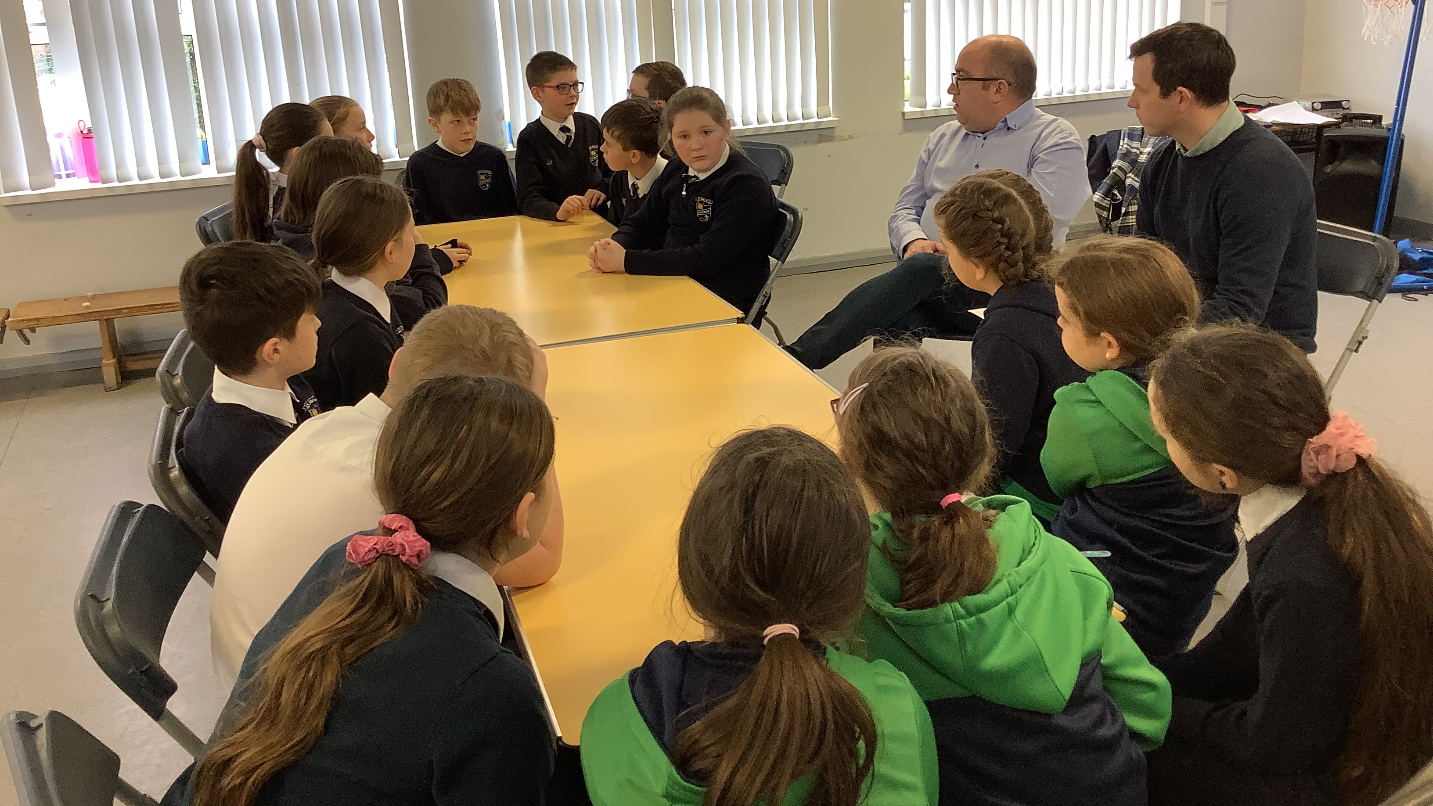
Student Council & Eco Team
Go Beyond What’s Possible

Slide 2
Today our student council members and the eco team met with some very important local people.

Slide 3
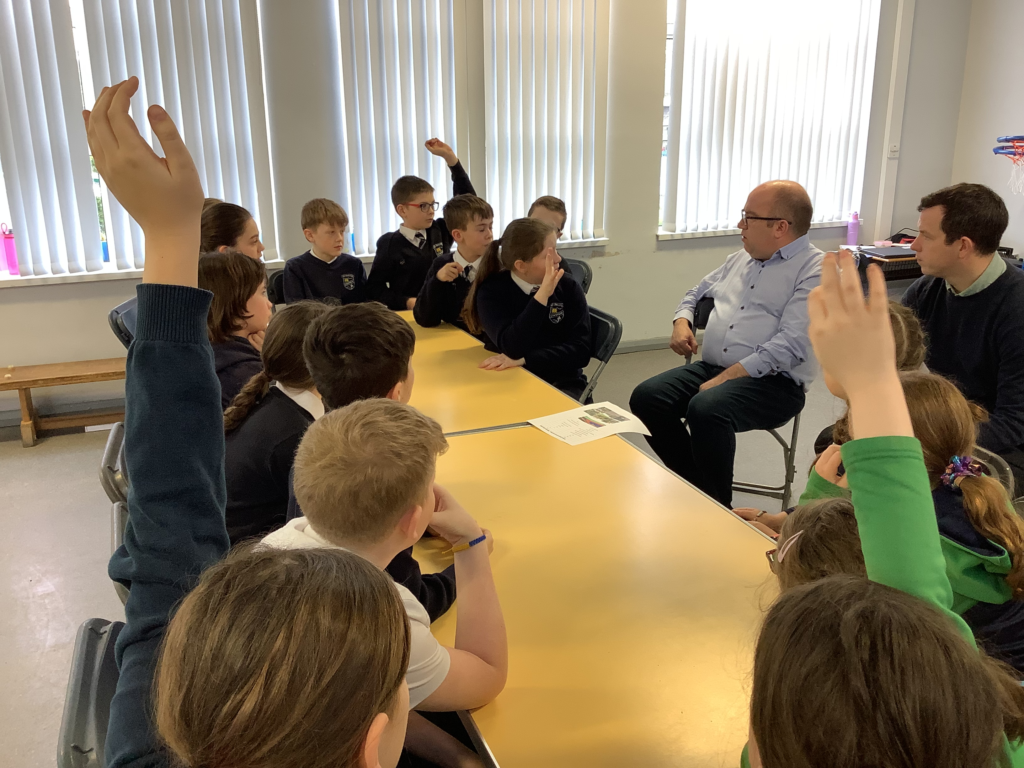
The students shared some super ideas for developing our outdoor area.

Slide 4
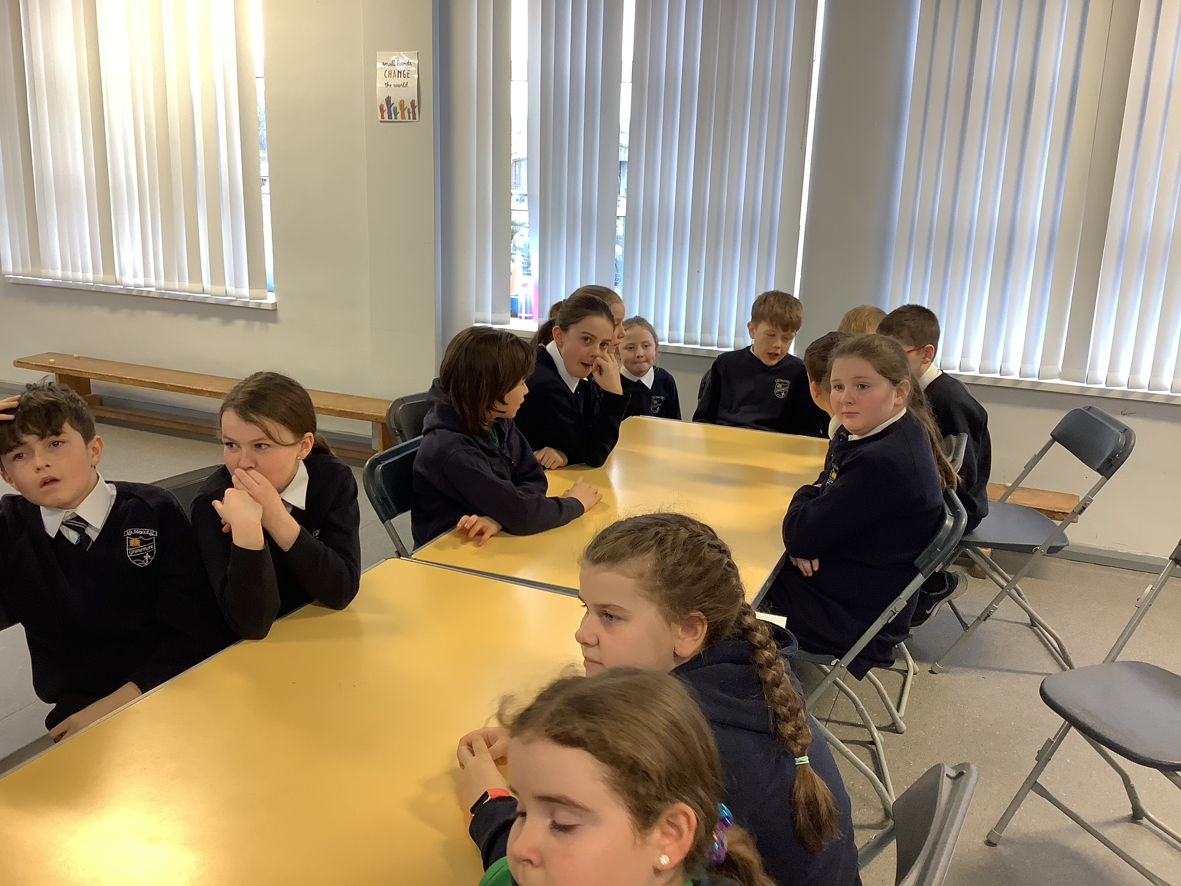
Thank you so much Thomas and john for the gift of your time. We are really enjoying this planning journey and can’t wait for the final result.

